Slide 1
Applied AI Operations Case Study:
Community Donation Outreach Automation
Operational leverage through measured AI-assisted workflow optimization

Slide 2
Background & Scaling Constraint
Two years ago, I founded a community outreach initiative called Community Healing Zone. It began through friends, family, and informal networks, with clothing and essential supply donations coming in steadily as we organized monthly events to take care of the homeless in my city.
Over time, donations began arriving faster than we could distribute them, and we ran out of storage space. It became clear that relying on personal networks alone wouldn’t scale the impact we wanted.
Churches felt like the natural next step for partnerships — but reaching out to them manually would take far too long.
Could AI increase outreach throughput without sacrificing personalization and quality?

Slide 3
Manual Baseline Performance
Average Time per Lead: 7m 48s (468 sec)
Leads per Hour: 7.69
Workflow required full manual scanning, drafting, and logging.
Primary friction: cognitive load + drafting time

Slide 4
AI-Assisted Workflow Performance
Average Time per Lead: 4m 13s (253 sec)
Leads per Hour: 14.23
AI synthesized outreach signals and generated personalized intros.
Human retained final judgment and send authority.

Slide 5
Efficiency Impact
Time Saved per Lead: 3m 35s (215 seconds)
Processing Time Reduction: 45.94%
Throughput Increase: 84.98%
Result: Nearly doubled outreach capacity in the same working time

Slide 6
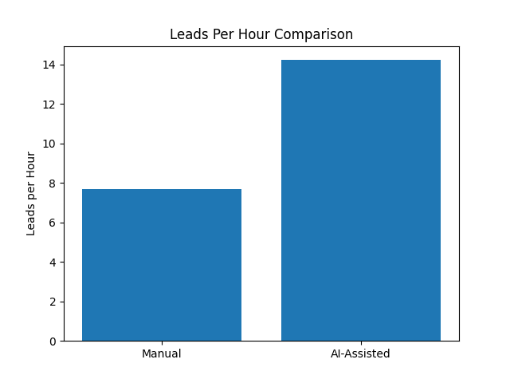
Throughput Comparison
(Leads Per Hour)

Slide 7
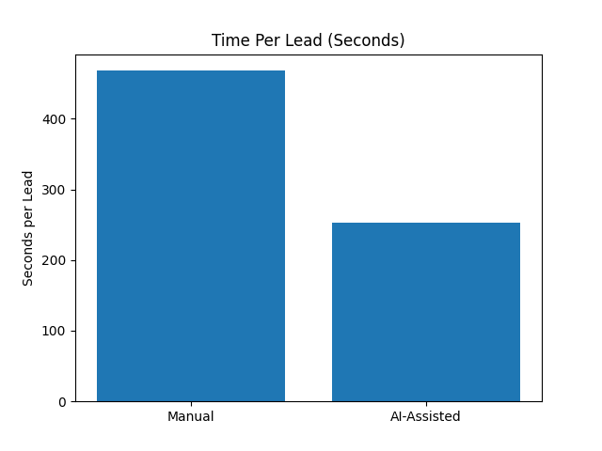
Time Reduction Per Lead (Seconds)

Slide 8
5-Hour Capacity Modeling
Manual Output: 38.46 churches
AI-Assisted Output: 71.15 churches
Net Gain: +32.69 additional churches
: Same operator. Same time. Materially higher yield.

Slide 9
Operational Insight & Next Phase
Remaining constraint: inconsistent website architecture.
AI eliminated drafting bottleneck; data retrieval now limits scale.
Next iteration: structured scraping + signal classification.

